Slide 1
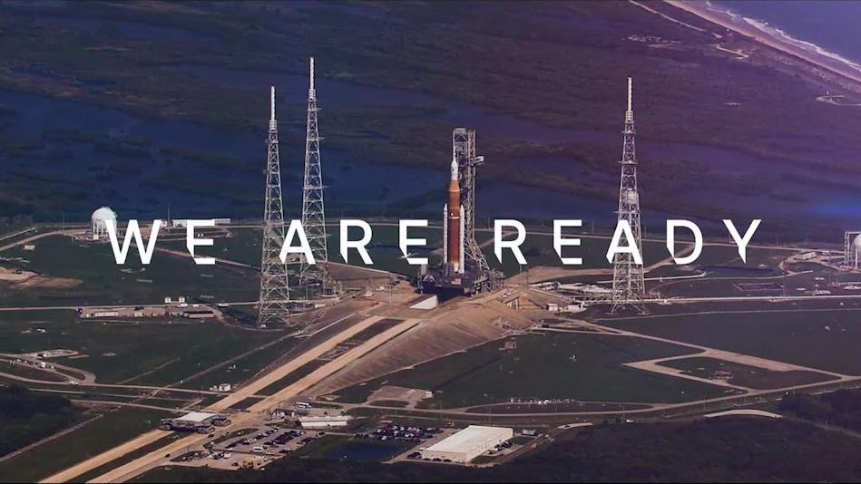
World Space Week 2022
Artemis I is ready for departure—and, together with NASA's partners around the world, we are ready to return to the Moon, with our sights on Mars and beyond. The uncrewed Artemis I mission will jump-start humanity’s return to the Moon with the thunderous liftoff of NASA’s powerful new Space Launch System rocket and Orion spacecraft.
Artemis I: We Are Ready (Video, 4:17)
Bonus: The Space Launch System of the Artemis I Moon Rocket (PDF Activity)
Tuesday, October 4th
Grades 6-8
Click here to view more space related resources in the Explore Space channel!

Slide 2
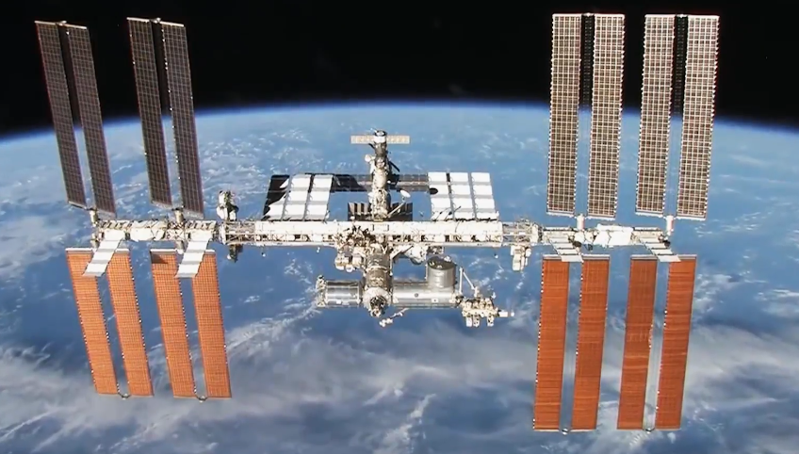
World Space Week 2022
Showcases James Dickson, an ISS mission evaluation room manager at Boeing, who works to provide engineering recommendations to the flight controllers on the International Space Station.
Engineering the International Space Station (Video, 3:01)
Wednesday, October 5th
Grades 6-8
Click here to view more space related resources in the Explore Space channel!

Slide 3
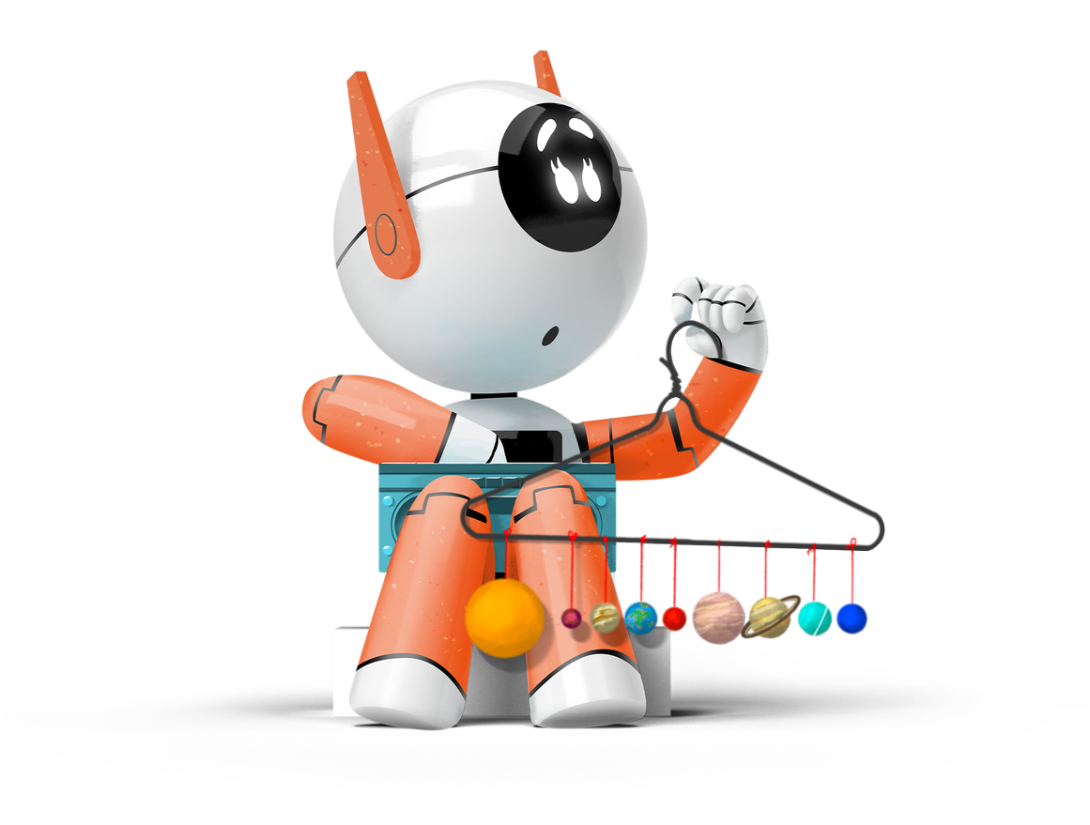
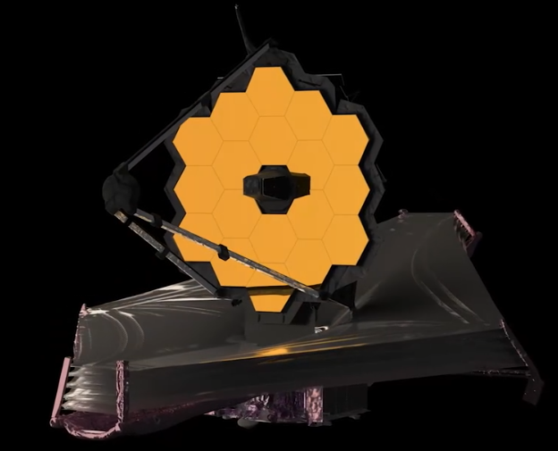
World Space Week 2022
Discover the largest, most powerful, and most technologically challenging space telescope ever built. In this program, students will be introduced to the James Webb Space Telescope, a machine so large that it must be folded like origami to fit inside its rocket for the ride to space.
An Introduction to the James Webb Telescope (Video, 3:43)
Click here for images from the James Webb Telescope!
Bonus: What is the James Webb Telescope? (PDF Activity)
Thursday, October 6th
Grades 6-8
Click here to view more space related resources in the Explore Space channel!

Slide 4
World Space Week 2022
This video explores Titan, Saturn’s largest moon, which is home to the first lakes discovered beyond Earth. The program reveals how NASA wants to build a submarine to explore them.
NASA’s Plan to Send a Submarine to Outer Space (Video, 3:03)
Friday, October 7th
Grades 6-8
Click here to view more space related resources in the Explore Space channel!

Slide 5
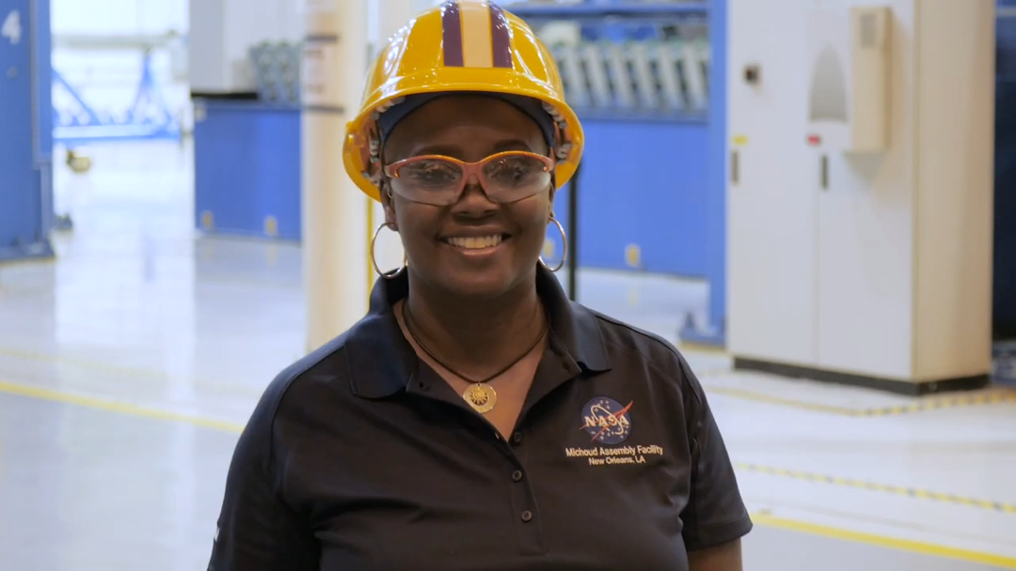
World Space Week 2022
Meet Renee Horton, a quality engineer at NASA's Michoud Assembly Facility in New Orleans. Renee works with the largest welding tool in the world helping to build the largest rocket ever built. Renee is leaving her footprints in history as NASA prepares to return to the Moon.
Faces of Technology: Meet Renee Horton (Video, 1:00)
Bonus: Destination: Space! (PDF Activity)
Monday, October 10th
Grades 6-8
Click here to view more space related resources in the Explore Space channel!

