Slide 1
COVID-19 Pandemic
Workplace
Safety and Health Awareness
1 Hour – Virtual Classroom Training

Slide 2
General Introduction
COURSE TITLE - COVID-19 Pandemic Workplace Safety and Health Awareness Training
STUDENT CONTACT HOURS - 1 Hour
COURSE DESCRIPTION - This awareness course is intended to increase workers' knowledge of hazards they may encounter on a job site related to the potential for occupational exposure to the SARS-CoV-2 virus. Training will emphasize what is a coronavirus, how is it spread, symptoms, how to protect workers, and cleaning and disinfecting
APPLICABLE STANDARDS - Respiratory protection (29 CFR 1910.134), PPE (personal protective equipment)(29 CFR 1910.132), OSHA’s Bloodborne Pathogens standard (29 CFR 1910.1030), Hazard Communication (29 CFR 1910.1200)

Slide 3
COVID-19 Pandemic Workplace Health and Safety Awareness Training
2020 Edition
Worker training grants from the National Institute of Environmental Health Sciences (NIEHS) provided the funding to produce this presentation.
© Copyright 2020 International Brotherhood of Teamsters Safety & Health Department 25 Louisiana Ave. N.W. Washington, D.C. 20001 (202) 624-6963 email – info@teamstersafety.org web - www.teamstersafety.org

Slide 4
Teamster Instructors
Teamster instructors use effective and participatory adult education methods, real equipment, and realistic hands-on activities. IBT instructors have experience doing the same types of jobs that trainees perform, including construction, remediation, warehousing and hazmat transportation. Instructors have completed the Department of Energy (DOE) Basic Instructor Training Program, the OSHA 500 Construction Trainer Course, and the OSHA 501 General Industry Trainer Course. The Teamsters certify each instructor after a period of supervised teaching and evaluation. To maintain certification, each instructor attends an annual Instructor Development Program that includes new regulations and work procedures, and practice teaching. Each Instructor is certified in first aid and CPR as well.

Slide 5
Teamster Training Centers
Teamster Training Centers have classrooms and outdoor areas for realistic hands-on activities. The Training Centers also have mobile units that can transport instructors and equipment to hold courses at hazardous waste sites, remediation projects, construction sites, company locations and union halls ... anywhere. For More Information For more information, or to schedule a course, contact: IBT Safety and Health Department 25 Louisiana Avenue, N.W. Washington, DC 20001 (202) 624-6963 (202) 624-8125 (fax) www.teamstersafety.org

Slide 6
About the Teamsters
Workers founded the International Brotherhood of Teamsters (IBT) in 1903. Today the Teamsters are a diverse union representing 1.4 million workers in transportation, construction, warehousing, and in almost every other type of employment. The IBT Safety and Health Department includes professionals in safety, industrial hygiene and adult education. Teamster Training The Teamsters offer safety and health training throughout the United States for: • Construction Workers • Hazardous Waste Workers • Railroad Workers • Industrial Workers • Hazardous Materials Transportation Workers • Emergency Responders • Radiological Workers

Slide 7
COVID-19 Pandemic - Workplace Safety and Health Awareness
MAIN MENU

Slide 8
INTRODUCTION

Slide 9
Learning Objectives
After completing this course, you will be able to demonstrate your ability to:
DEFINE what is COVID-19
EXPLAIN how is SARS-CoV-2 virus spread
DESCRIBE COVID-19 symptoms
DESCRIBE and LIST how to protect workers from exposure to COVID-19
DESCRIBE cleaning and disinfecting procedures

Slide 10
OSHA Standards
Several OSHA standards and directives are directly applicable to protecting workers against transmission of infectious agents. These include:
OSHA's Bloodborne Pathogens standard (29 CFR 1910.1030) which provides protection of workers from exposures to blood and body fluids that may contain bloodborne infectious agents
OSHA's Personal Protective Equipment standard (29 CFR 1910.132)
Respiratory Protection standard (29 CFR 1910.134) which provide protection for workers when exposed to contact, droplet and airborne transmissible infectious agents; and OSHA's TB compliance directive which protects workers against exposure to TB through enforcement of existing applicable OSHA standards and the General Duty Clause of the OSH Act
OSHA HAZCOM standard 29CFR 1910.1200 including GHS

Slide 11
Employer and Worker Responsibilities
Employers and workers have responsibilities under the OSH Act.
• The Occupational Safety and Health Act requires that employers provide a safe and healthy workplace free of recognized hazards and follow OSHA standards
• Workers should participate in the development and implementation of the employer’s safety and health policies and help ensure that they are appropriate and implemented
Notes:
Instructor notes:
Although there is no OSHA standard that deals specifically with the coronavirus, there are OSHA standards that cover PPE and respiratory protection addressed in more detail later in this program. Many of these OSHA standards include training requirements for workers. See Module 3 for some of those standards.
The OSHA general duty clause requires employers to provide a workplace free of recognized hazards that can cause serious physical harm or death to workers. https://www.osha.gov/laws-regs/oshact/section5-duties
Workers have a right to file anonymous confidential complaints with OSHA. It is usually a good idea to try to resolve safety and health problems with employers before filing an OSHA complaint. It is also recommended to speak directly with the area OSHA office personnel to obtain assistance in filing a complaint.
There are also several whistleblower laws that protect workers if they are discriminated against or experience job loss or other negative impacts on their employment as a result of complaining about unsafe and unhealthy conditions. https://www.osha.gov/whistleblower/WBComplaint.html
Workers, unions, and the public have filed complaints with OSHA, public health authorities, political leaders, and the police during the pandemic when employers refused to maintain social distancing or other basic worker protections.
A petition for an OSHA Infectious Disease Standard was submitted in 2009 and has been on the OSHA regulatory agenda in 2017 for “long term action”.
https://www.osha.gov/dsg/id/
Many advocates have been working to get an OSHA Emergency Temporary Standard to address worker protection from SARS-CoV-2. Occupational Safety and Health Administration (OSHA): Emergency Temporary Standards (ETS) and COVID-19 , Congressional Research Service, Updated April 8, 2020. https://fas.org/sgp/crs/misc/R46288.pdf

Slide 12
WHAT IS COVID-19

Slide 13
What is COVID-19 - Learning Objectives
After completing this chapter, you will be able to demonstrate your ability to:
DEFINE what is COVID-19
EXPLAIN what is a Pandemic
LIST who are at high risk
EXPLAIN COVID-19 in World and US

Slide 14
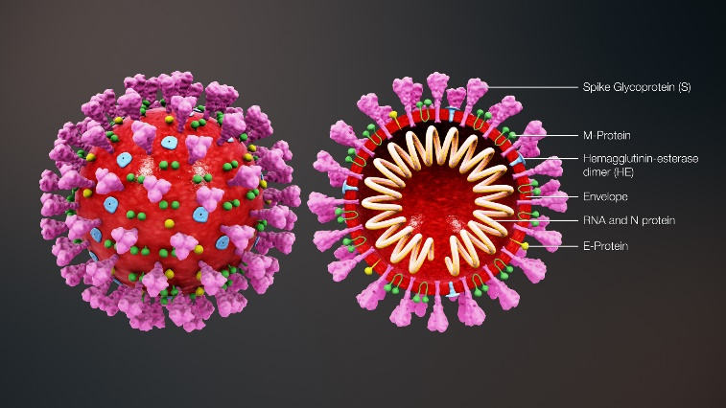
What is COVID-19?
Coronavirus disease 2019 (abbreviated COVID-19) is an infectious disease caused by the most recently discovered coronavirus, named “SARS-CoV-2”
Coronaviruses are a large family of viruses that are common in people and many different species of animals, including camels, cattle, cats, and bats.
Notes:
Instructor notes:
The virus has been named “SARS-CoV-2” and the disease it causes has been named “coronavirus disease 2019” (abbreviated “COVID-19”). Throughout this training we refer to the virus as SARS CoV-2 and the disease as COVID-19.
Coronaviruses are a large family of viruses that are common in people and many different species of animals, including camels, cattle, cats, and bats. Rarely, animal coronaviruses can infect people and then spread between people such as with MERS-CoV, SARS-CoV, and now with this new virus (named SARS-CoV-2).
The SARS-CoV-2 virus is a betacoronavirus, like MERS-CoV and SARS-CoV. All three of these viruses have their origins in bats. The sequences from U.S. patients are similar to the one that China initially posted, suggesting a likely single, recent emergence of this virus from an animal reservoir. (https://www.cdc.gov/coronavirus/2019-nCoV/summary.html)
The SARS-CoV-2 virus is a novel strain, meaning that it is new. As a result, humans have not developed immunity to COVID-19, and therefore can be infected. Acquired immunity is when humans have been exposed or vaccinated previously to an infectious agent. An example is when people have measles in childhood or are vaccinated, they develop antibodies and a certain level of protection.
Early on, many of the patients at the epicenter of the outbreak in Wuhan, Hubei Province, China had some link to a large seafood and live animal market, suggesting animal-to-person spread. Later, a growing number of patients reportedly did not have exposure to animal markets, indicating person-to-person spread. Person-to-person spread was subsequently reported outside Hubei and in countries outside China, including in the United States. Some international destinations now have apparent community spread with the virus that causes COVID-19, as do some parts of the United States. Community spread means some people have been infected and it is not known how or where they became exposed.

Slide 15
What is COVID-19? (cont.)
This new virus and disease were unknown before the outbreak began in Wuhan, China, in December 2019
Spreads easily person-to-person
Little if any immunity in humans
Notes:
Severe acute respiratory syndrome (SARS) is a viral respiratory illness caused by a coronavirus called SARS-associated coronavirus (SARS-CoV). SARS was first reported in Asia in February 2003. The illness spread to more than two dozen countries in North America, South America, Europe, and Asia before the SARS global outbreak of 2003 was contained.
Since 2004, there have not been any known cases of SARS reported anywhere in the world.

Slide 16
What is a Pandemic?
Global outbreak of disease
Pandemics happen when a new virus emerges to infect people and can spread between people sustainably
Because there is little to no pre-existing immunity against the new virus, it spreads worldwide
On March 11, 2020 the COVID-19 outbreak was characterized as a pandemic by the WHO
Notes:
What is a Pandemic?
A pandemic is a global outbreak of disease. Pandemics happen when a new virus emerges to infect people and can spread between people sustainably. Because there is little to no pre-existing immunity against the new virus, it spreads worldwide. The virus that causes COVID-19 is infecting people and spreading easily from person-to-person. Cases have been detected in most countries worldwide and community spread is being detected in a growing number of countries. On March 11, the COVID-19 outbreak was characterized as a pandemic by the WHO.

Slide 17
COVID in the World
The virus has spread to every continent except Antarctica
Over 11.6 million people test positive (updated July 7, 2020) – Over 17.9 million (updated Aug. 3, 2020)
Over 540 thousand fatal cases (updated July 7, 2020) – Over 690 thousand fatal cases (updated Aug. 3, 2020)
Notes:
Prior to class Instructor must research and present current COVID-19 numbers
World Health Organization
https://who.sprinklr.com/
Coronavirus COVID-19 Global Cases by the Center for Systems Science and Engineering (CSSE) at Johns Hopkins University
https://coronavirus.jhu.edu/map.html
Microsoft COVID map
https://www.bing.com/covid

Slide 18
COVID-19 in the US
COVID-19 is spreading rapidly within the United States. The outbreak has been declared a national emergency in the United States and a global pandemic by the World Health Organization.
In July 2020 started a second rise of people are testing positive
3 million people test positive (updated July 7, 2020) – 4.7 million people test positive (updated Aug. 3, 2020)
140 thousand fatal cases (updated July 7, 2020) – 157 thousand fatal cases (updated Aug 3, 2020)

Slide 19
COVID-19 in the US cont.
The virus that causes COVID-19 seems to be spreading easily and sustainably in the community (community spread) in affected areas
The virus can cause mild to severe respiratory illness, at times resulting in death
Both in healthy adults
Elderly people with existing health problems or a weaker immune system

Slide 20
How widespread could it get?
It has caused severe illness and death. It features sustained person-to-person spread worldwide
Protecting essential worker is paramount. Workers who work with the public
Not following proper protocols to prevent spread.
Lack of wearing face coverings
Lack of Social Distancing
Poor hand hygiene
Lack of cleaning or disinfecting work areas, common surface contact

Slide 21
Who are at Higher Risk for Severe Illness?
The elderly (60 or older)
People who live in a nursing home or long-term care facility
People of all ages with underlying medical conditions
High blood pressure
Heart conditions
Notes:
Who are at Higher Risk for Severe Illness?
Everyone is at risk for getting COVID-19 if they are exposed to the virus. Some people are more likely than others to become severely ill, which means that they may require hospitalization, intensive care, or a ventilator to help them breathe, or they may even die. We learn more about COVID-19 every day, and as more information becomes available, CDC will continue to update and share information about risk for severe illness.
In general, your risk of getting severely ill from COVID-19 increases as you get older. In fact, 8 out of 10 COVID-19-related deaths reported in the United States have been among adults aged 65 years and older.

Slide 22
Who are at Higher Risk for Severe Illness? Cont.
Immunocompromised (Cancer treatment, bone marrow or organ transplantation, immune deficiencies, HIV or AIDS, and immune weakening medications
Severe obesity
Diabetes
Chronic kidney disease
Liver disease

Slide 23
Worldwide Distribution Map
World Health Organization
https://who.sprinklr.com/
Coronavirus COVID-19 Global Cases by the Center for Systems Science and Engineering (CSSE) at Johns Hopkins University
https://coronavirus.jhu.edu/map.html
Microsoft COVID map
https://www.bing.com/covid

Slide 24
HOW DOES COVID-19 SPREAD

Slide 25
COVID Spread Learning Objectives
Learning Objectives After completing this chapter, you will be able to demonstrate your ability to: EXPLAIN how is COVID-19 spread
DESCRIBE how does COVID-19 become contagious
DEFINE what is community spread

Slide 26
US situation as of July 2020
Experts are predicting that COVID will spread
Those with elevated risk of exposure include:
Close contacts of persons with COVID-19
Healthcare workers caring for patients with COVID-19
Different levels of COVID-19 activity in States
Community spread
Young people socializing
Essential workers
The entire country is reopening at different levels causing an increasing number of positive test results

Slide 27
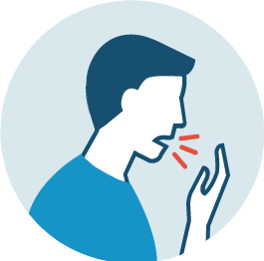
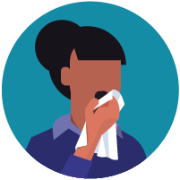
HOW DOES COVID-19 SPREAD?
New research has indicated that SARS-CoV-2 may spread by
Respiratory droplets – from coughing or sneezing, and talking and breathing
Aerosolized transmission – virus can live in the air for up to 3 hours. When you breathe air that has the virus floating
Environmental contact – touching someone or something with the virus on it and then touching mouth, nose, or eyes
Fecal-oral transmission – spread through contact with an infected person's stool
Notes:
Instructor notes:
Spread of SARS-CoV-2, the virus that causes COVID-19, is thought to occur in the same way that seasonal flu spreads. Flu viruses are spread mainly from person to person through coughing or sneezing by people with influenza. We will not fully know how it is transmitted until later when scientists have had time to evaluate it.
Droplet transmission occurs when respiratory secretions from coughing or sneezing land on mucosal surfaces (nose, mouth, and eyes).
Contact transmission is touching something with COVID-19 virus on it and then touching your mouth, nose or eyes.
Aerosol transmission means breathing in infectious COVID-19 particles.
Keep in mind that the virus particles are not visible to the naked eye. The most harmful particles are sub micron, shorter than one millionth of a meter.
It is not likely that SARS CoV-2 is airborne like tuberculosis or measles, but there is strong evidence that it is spread by short range aerosols. See: CIDRAP: COMMENTARY: COVID-19 transmission messages should hinge on science https://www.cidrap.umn.edu/news-perspective/2020/03/commentary-covid-19-transmission-messages-should-hinge-science

Slide 28
What is Community Spread?
When someone gets the virus without any known contact with a sick person
25 percent to 80 percent of people with COVID-19 are unaware they have the virus
Some studies say each person who is infected by the virus has the potential to spread it to four other persons

Slide 29
When do you become contagious?
A person starts being contagious during the “incubation period”
Time between catching the virus and beginning to have symptoms of the disease, which is up to 14 days
COVID-19 symptoms may show 2-14 days after exposure
People are most contagious when they are the most symptomatic
People who are infected may be contagious before they develop symptoms or even if they never develop symptoms (asymptomatic)

Slide 30
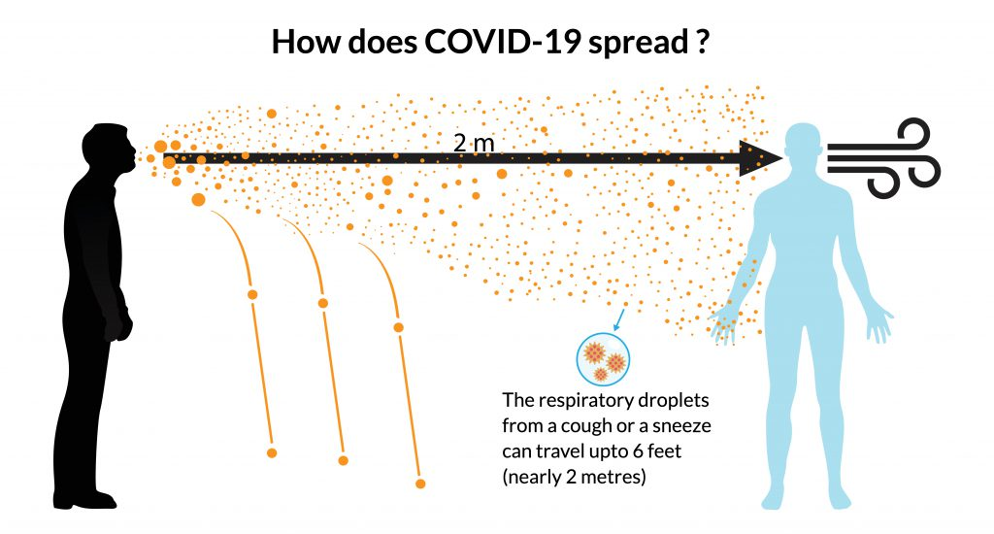
Person-to-person spread
COVID-19 transmitted most efficiently from direct person to person contact, through:
Respiratory droplets produced when an infected person coughs or sneezes:
These droplets can land in the mouths, noses or eyes of people who are nearby or possibly be inhaled into the lungs

Slide 31
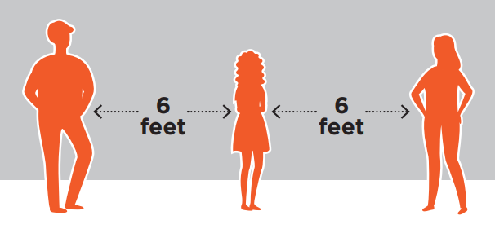
Person-to-person spread cont.
Spread is most likely among close contacts (about 6 feet)
Close contact is defined as-
Being within approximately 6 feet (2 meters) of a COVID-19 case for a prolonged period
Close contact can occur while caring for, living with, visiting, or gathering in groups
Having direct contact with infectious secretions of a COVID-19 case

Slide 32
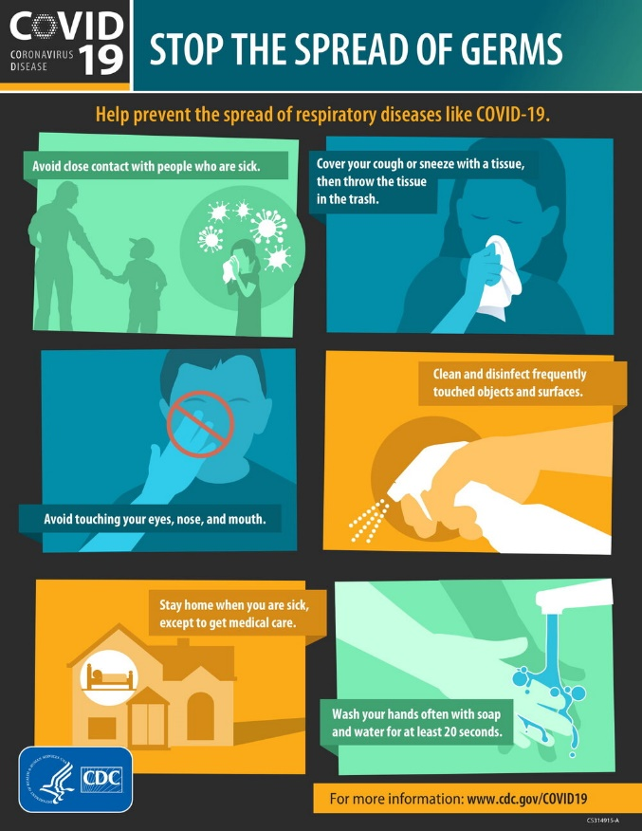
Spread from contact with infected surfaces or objects
A person can get indirect transmission of the COVID-19 virus by:
Touching a surface or object that has the virus on it then
Touching their own mouth, nose, or eyes
Notes:
Spread from contact with infected surfaces or objects
It may be possible that a person can get indirect transmission of the COVID-19 virus by touching a surface or object that has the virus on it and then touching their own mouth, nose, or possibly their eyes, but this is not thought to be the main way the virus spreads.
A recent laboratory study by researchers at the National Institutes of Health (NIH), the Centers for Disease Control and Prevention (CDC) and other academic institutions found that viable SARS-CoV-2 virus could be detected:
in aerosols up to 3 hours post aerosolization,
up to 4 hours on copper,
up to 24 hours on cardboard, and
up to 2-3 days on plastic and stainless steel.

Slide 33
How to protect yourself against COVID-19
Notes:
Video length 00:01:29

Slide 34
WHAT ARE THE SYMPTOMS

Slide 35
What Are the Symptoms - Learning Objectives
Learning Objectives After completing this chapter, you will be able to demonstrate your ability to: DESCRIBE & LIST what are the symptoms of COVID-19

Slide 36
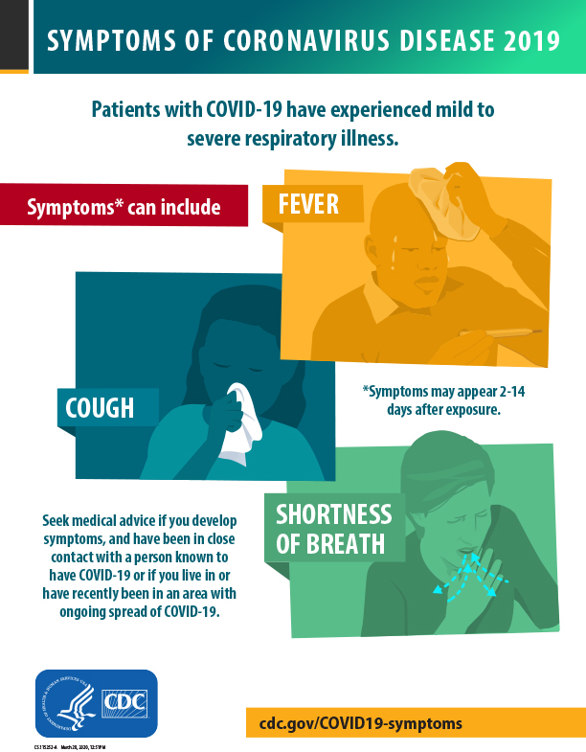
WHAT ARE THE SYMPTOMS OF COVID-19?
The following symptoms may appear 2-14 days after exposure. These symptoms are usually mild to severe:
Fever
Cough
Shortness of breath
Sore throat

Slide 37
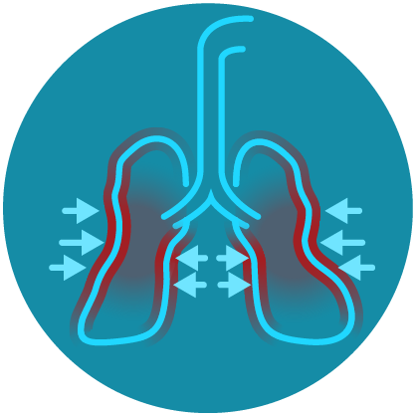
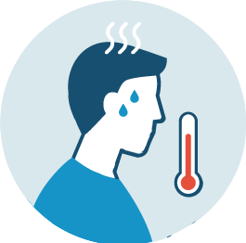
Other symptoms may include
Runny or stuffy nose
Body aches
Headache
Chills
Fatigue
No sense of taste or smell
This list is not all possible symptoms. Other less common symptoms have been reported, including gastrointestinal symptoms like nausea, vomiting, or diarrhea.

Slide 38
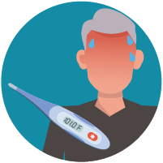
EMERGENCY SYMPTOMS OF COVID-19?
Emergency warning signs include
Get medical attention immediately if you have:
Difficulty breathing or shortness of breath
Persistent pain or pressure in the chest
Confusion or inability to arouse
Bluish lips or face

Slide 39
HOW TO PROTECT WORKERS

Slide 40
How To Protect Workers - Learning Objectives
Learning Objectives After completing this chapter, you will be able to demonstrate your ability to: EXPLAIN exposure factors in the workplace
DESCRIBE and LIST workers who are at increased risk for COVID-19
LIST Hierarchy of Controls
EXPLAIN Mental health & stress

Slide 41
WHICH WORKERS ARE AT INCREASED RISK?
Workers who are at increased risk include:
Essential workers
Health care (including Pre-hospital and Medical transport workers, Healthcare providers, Clinical laboratory personnel, and Support staff)
Emergency responders (e.g., Law enforcement, Firefighters, EMTs)
Transportation workers (Airline, Highway, Rail, Commuter transport)
Construction
Waste workers

Slide 42
WHICH WORKERS ARE AT INCREASED RISK? cont..
Workers who are at increased risk include:
Custodial workers
Meat and Poultry processing
Correctional workers
Educators
Deathcare (including Coroners, Medical examiners, and Funeral directors)
Other workers with broad exposure to the public

Slide 43
Key exposure factors in the workplace
Does the work setting require close contact
Do specific job duties require repeated or extended contact with people
Increase Distance + Decrease Time = lower risk and decreases exposure
Notes:
Instructor notes:
How can you determine if your risk for COVID-19 is greater where you work than in the general population? First, consider
whether the type of setting you work in requires close proximity to people potentially infected with the COVID-19 virus. Next, ask whether your specific job duties require you to have either repeated, extended or close contact with known or suspected sources of the virus.
For example, a hospital is a work setting where there will be a greater concentration of individuals who have or are suspected of having the coronavirus.
However, employees who work in the same facility have different risks depending on what part of the institution they work in and the tasks that they perform. Staff who provide bedside care to a patient with COVID-19 have a higher risk of becoming infected at work than someone working in the billing office.

Slide 44
Contributing Factors to Exposure Dose
Density: How many people are in one place, and how closely?
What is the density of your city or of a chosen activity?
Volume of airflow directly impacts infection risk and explains why a crowded bar/concert/movie theatre significantly raises risk
Outdoors may mitigate risk, crowds themselves present an inherent risk, especially if densely packed

Slide 45
Contributing Factors to Exposure Dose pt 2.
Degree of activity: Activities with loud speaking or intense physical activity all increase the risk of transmission
Singing, shouting, exercising — each of these carry additional risk

Slide 46
Contributing Factors to Exposure Dose pt 3.
Duration: Probability of infection is directly linked to duration of exposure
Living in the same house with someone who is acutely ill is high risk
A quick pass-by on a street is less exposure

Slide 47
Contributing Factors to Exposure Dose pt. 4
Distance: We all know the 6-foot rule — but let’s be clear: there is no law that COVID cannot cross 6 feet. In some instances, germs can travel 10 and even 20 feet

Slide 48
IS THERE A VACCINE, DRUG, OR TREATMENT FOR COVID-19?
To date, there is no vaccine and no specific antiviral medicine to prevent or treat COVID-2019
Several clinical trials have started
Antibiotics do not work against COVID-19 because antibiotics only work on bacterial infection
People with serious illnesses should be hospitalized where supportive care (IV Fluids) is administered to support the body's immune system

Slide 49
WHAT ARE THE MOST EFFECTIVE WAYS TO PROTECT WORKERS?
Measures for protecting workers depend on the type of work being performed and exposure risk
Workers are best protected when their employer conducts a:
Hazard assessment to identify risk
Follows OSHA regulations and best practices in choosing an abatement method for the identified hazard and utilize the “hierarchy of controls”
Employers should adopt infection control strategies

Slide 50
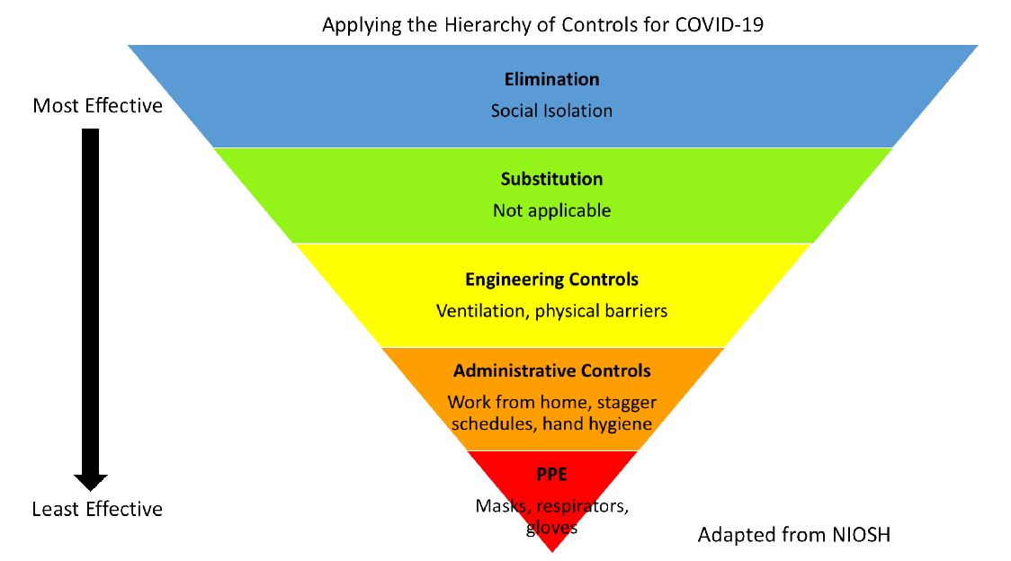
Hierarchy of Controls

Slide 51
Hierarchy of Controls pt. 2
Elimination
Social Isolation - Stay home, avoid public
areas, work remotely, virtual meetings
Engineering Controls
Ventilation
Bring in fresh air regularly
Physical barriers and partitions
Air purifier using HEPA filter
Eliminate touchpoints in high traffic areas
Notes:
elimination – physically removing the hazard (COVID-19). For workplaces deemed necessary, such as hospitals, supermarkets, and banks, this means making sure workers are not coming in when they are ill or have potentially been exposed to others who are ill. In this way, we can eliminate (to the best of our ability) the means of transmission among the workers. For the general public, this means eliminating unnecessary trips to the store or other places where you could come in contact with infected individuals and keeping your distance (6 ft)⁴ from other people when you must be away from your home. It also means staying home if you are sick or suspect that you have been around someone who is sick. Social isolation is one of our best tools to reduce the spread of infection. Social isolation is especially important in the context of COVID-19 because many individuals are asymptomatic and can, unknowingly, spread the virus any time they leave their home.
engineering controls – separating the workers from the hazard. This is achieved in hospitals with a high ventilation rate that removes the air from a room where virus may be found. Some companies are installing extra barriers between workers and consumers. In homes, individuals may choose to run filtered home HVAC systems or open windows to bring in fresh air regularly. You might also choose to run an air purifier.

Slide 52
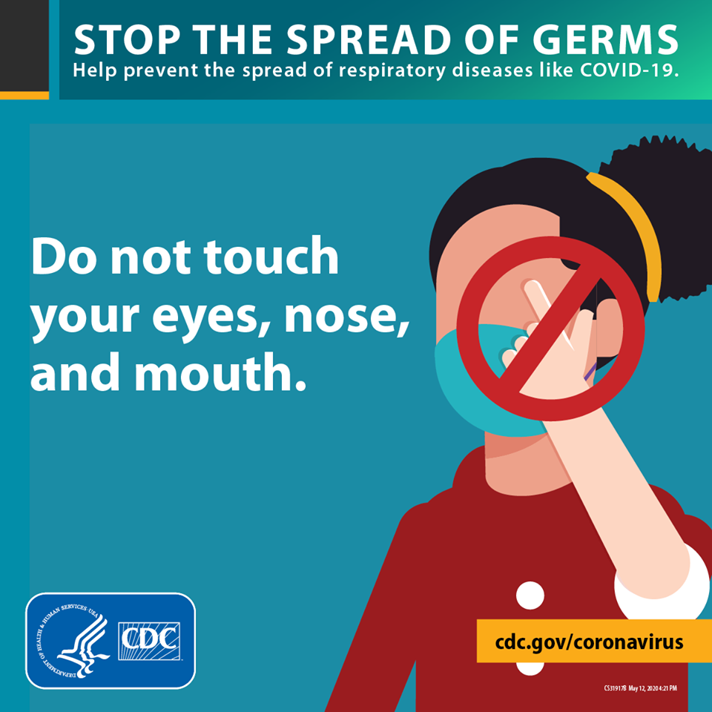
Hierarchy of Controls pt. 3
Administrative Controls
Social Distancing
Use signage floor and wall markings to promote distancing
Stagger Schedules
Work from Home
Proper Hand Hygiene or sanitizer
Do not touch eyes, nose, mouth, and face
Notes:
administrative controls – changing the way work is performed. For workplaces this can mean instituting work from home policies for all non-essential personnel. Many cities and states have already implemented this control. For essential personnel and workplaces, it can mean reducing the number of workers on a shift and keeping workers further apart. Staggering work schedules so people don’t have to come in contact with their shift replacement can also help. Some companies have also implemented buying online with curbside pick-up.

Slide 53
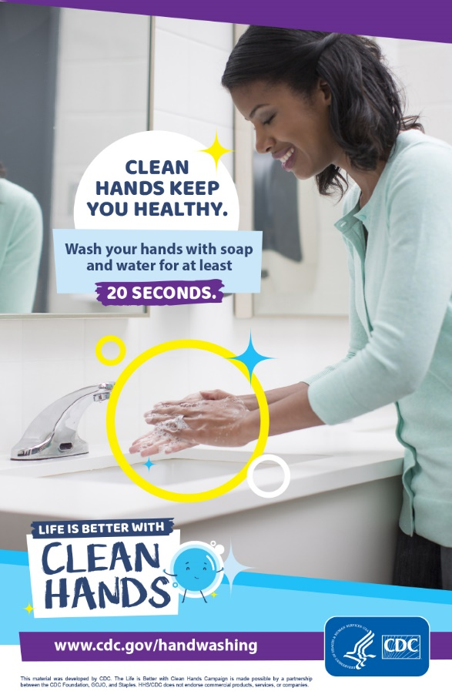
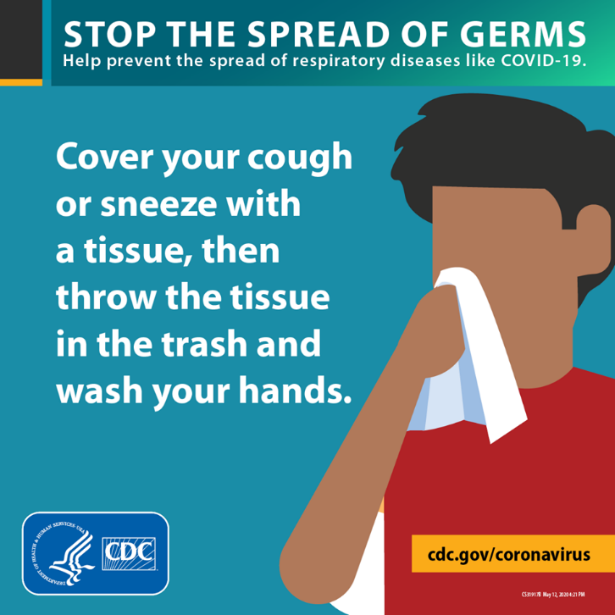
Hierarchy of Controls pt.4
Administrative Controls
Cough and Sneeze Etiquette Procedure
Disinfection procedures
Health monitoring

Slide 54
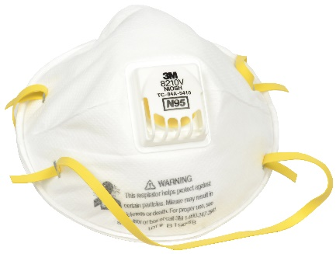
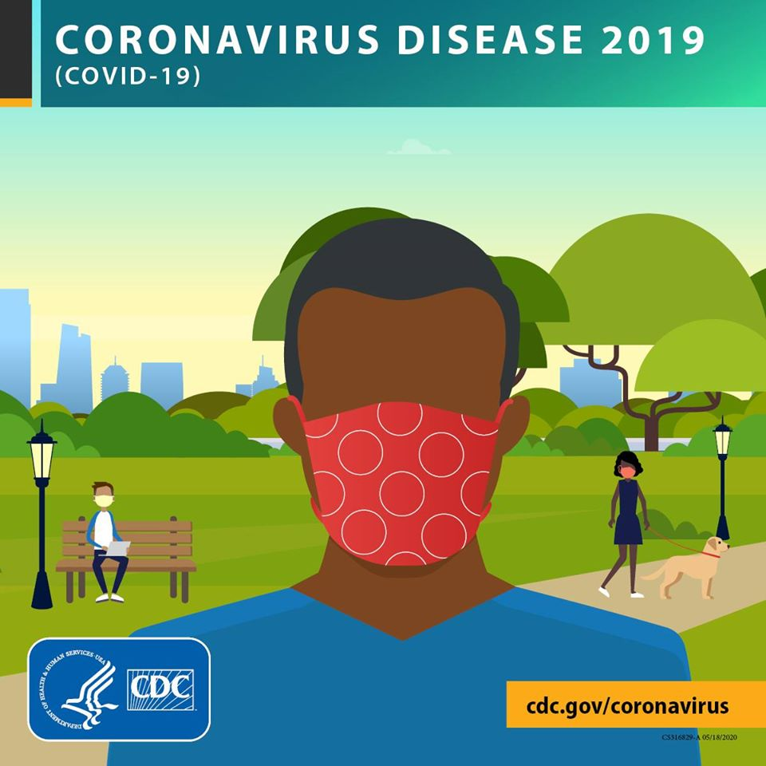
Hierarchy of Controls pt. 5
PPE
Respirators (N95)
Cloth mask
Gloves
Face shield

Slide 55
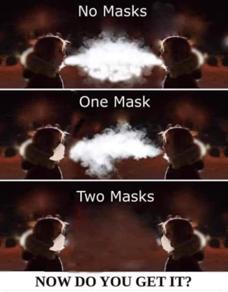
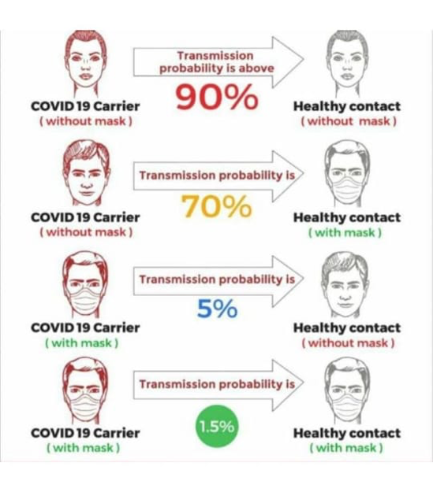
Why wear a cloth mask?
To protect yourself from inhaling virus-containing particles
To limit the number of virus-containing particles exhaled by infected (potentially asymptomatic) individuals
Cloth masks reduce the number of virus-containing droplets exhaled by infected people
Notes:
There are two reasons to use a mask: 1) to protect yourself from inhaling virus-containing particles; and 2) to limit the number of virus-containing particles exhaled by infected (but potentially asymptomatic) individuals. Homemade masks are unlikely to protect you from infection, but they may reduce the number of virus-containing droplets exhaled by infected people.

Slide 56
REMEMBER – It’s not one thing, it is applying all to prevent spread and possible exposure!!
Use of cloth masks
Use of social distancing
Regularly washing hands with soap and water for 20 seconds
Use of hand sanitizer with at least 70% alcohol
Clean, sanitize and disinfect surfaces of equipment, tools, and or items that are touched regularly
Ensure proper ventilation

Slide 57
Putting on and taking off a mask
Notes:
Video length 00:02:02

Slide 58
Mental health & stress
As the number of cases of COVID-19 increase, so does the associated anxiety and stress. Consider the following steps:
Use your smart phone to stay connected to family and friends. Shift from texting to voice or video calling to feel more connected
Keep comfortable. Do more of the things you enjoy doing at home
Practice stress relief whenever you feel anxiety building – do some deep breathing, exercise, read, whatever works for you
Avoid unhealthy behavior such as excess drinking – that will just increase your anxiety afterwards
Keep looking forward. Make some plans for six months down the road
Notes:
Instructor notes:
See the NIEHS Disaster Worker Resiliency Training for additional training opportunities. https://tools.niehs.nih.gov/wetp/index.cfm?id=2528
These materials prepare workers to recognize and understand their reactions to stress and traumatic events. The four-hour interactive program focuses on self-care strategies and reviews positive and negative reactions to trauma and stress.
Self-care includes:
Adequate sleep. Seven to 8 hours according to federal guidelines.
Healthy eating. Avoid caffeine, sugar, etc.
Exercise or other forms of movement can help reduce the stress reaction.
Relaxation. Give yourself a break from thinking about the crisis and work.
It is very important for workers to be aware of job stressors and seek professional assistance when needed.

Slide 59
Workplace Guidance
Click on image to open pdf

Slide 60
Cleaning and Disinfection: What You Need to Know

Slide 61
Cleaning and Disinfecting - Learning Objectives
Learning Objectives After completing this chapter, you will be able to demonstrate your ability to: DESCRIBE and EXPLAIN Cleaning and Disinfecting Your Home

Slide 62
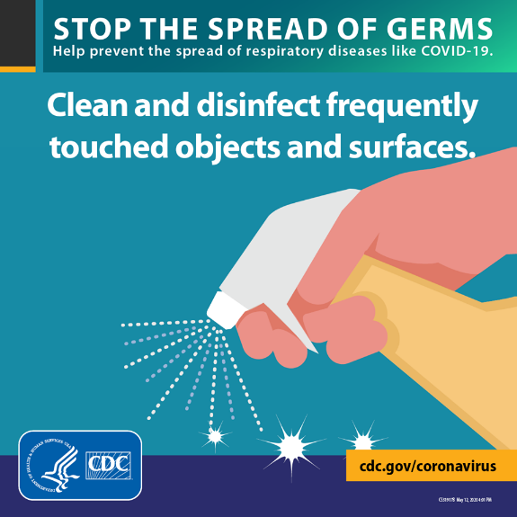
Cleaning and Disinfection
Clean
Wear reusable or disposable gloves for routine cleaning and disinfection
Clean surfaces using soap and water, then use disinfectant
Cleaning with soap and water reduces number of germs, dirt and impurities on the surface. Disinfecting kills germs on surfaces
Refer to Hazard Communication (29 CFR 1910.1200) on chemical hazards and toxic substances

Slide 63
Cleaning and Disinfection pt. 2
Clean
Practice routine cleaning of frequently touched surfaces. High touch surfaces include:
General – Tables, doorknobs, light switches, countertops, handles, desks, phones, keyboards, toilets, faucets, sinks, etc.
Hotel – light switches, door handles, and bathroom surfaces, remote control
Vehicles – steering wheel, door locks and handles, key area handbrake, seatbelt fittings/clips, console area
Railroad – desktops, control panels, switches, throttles, dynamic brake, telephones, seatbelt fittings/clips, center console area, grab handles, chair and armrest, steering wheels, gear shifters, window and door locks and handles, and other tools and equipment

Slide 64
Cleaning and Disinfection pt. 3
Disinfect – kills virus
Recommend use of EPA-registered household disinfectant Follow the instructions on the label to ensure safe and effective use of the product. Many products recommend:
Keeping surface wet for a period of time (see product label)
Precautions such as wearing gloves and making sure you have good ventilation during use of the product

Slide 65
Cleaning and Disinfection pt. 4
Always read and follow the directions on the label to ensure safe and effective use
Wear skin protection and consider eye protection for potential splash hazards
Ensure adequate ventilation
Use no more than the amount recommended on the label
Use water at room temperature for dilution (unless stated otherwise on the label)
Avoid mixing chemical products
Label diluted cleaning solutions
Store and use chemicals out of the reach of children and pets

Slide 66
How to Clean and Disinfect Your Home if Someone has COVID-19
Notes:
This video explains the concepts of cleaning and disinfecting in the home but can be used for the workplace.
Video Length 00:02: 03

Slide 67
Resources
For more information visit CDC website
https://www.cdc.gov/coronavirus/2019-nCoV/index.html
Click on image to open pdf

Slide 68
Thank you for your participation

