Slide 1
How to quote & enroll members into Optima Unique Plans

Slide 2
Optima Unique plans
OptimaFit Direct Unique Off-Exchange plans are only offered outside the Marketplace (Off Exchange).
There are only 2 Unique plans: OptimaFit Silver 3500/30% Direct & OptimaFit Silver 3000/30% HSA Direct.
Can only be quoted on www.optimahealth.com.
Cannot be quoted on TFA Edge or HealthSherpa.
These unique Off Exchange plans offer lower premiums and include comprehensive benefits, wellness programs, preventive services.
Members can apply via optimahealth.com or paper application.

Slide 3
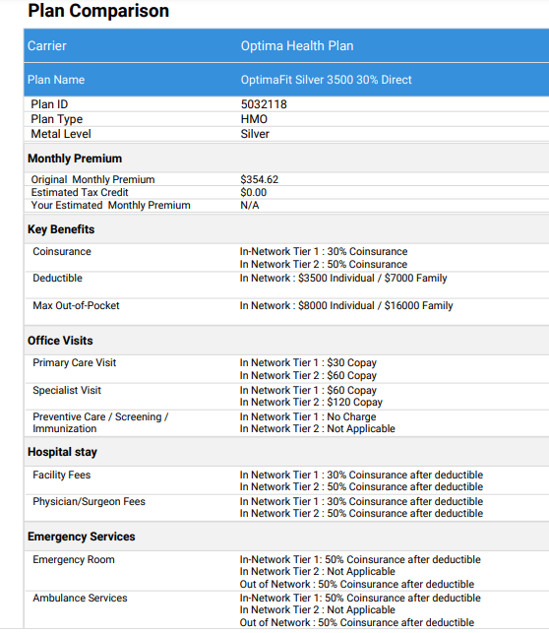
Rate comparison for a 43 year-old female in Norfolk, VA
Optima Unique Plan: Optima Silver 3500 30% Direct
Optima Plan: Optima Silver 3800 25% Direct

Slide 4
Login to www.optimahealth.com

Slide 5
Sign in as a Broker

Slide 6
Enter username and password

Slide 7
Select “Individual Renewals”

Slide 8
Select “Get Online Estimate”

Slide 9
Enter client’s demographic information

Slide 10
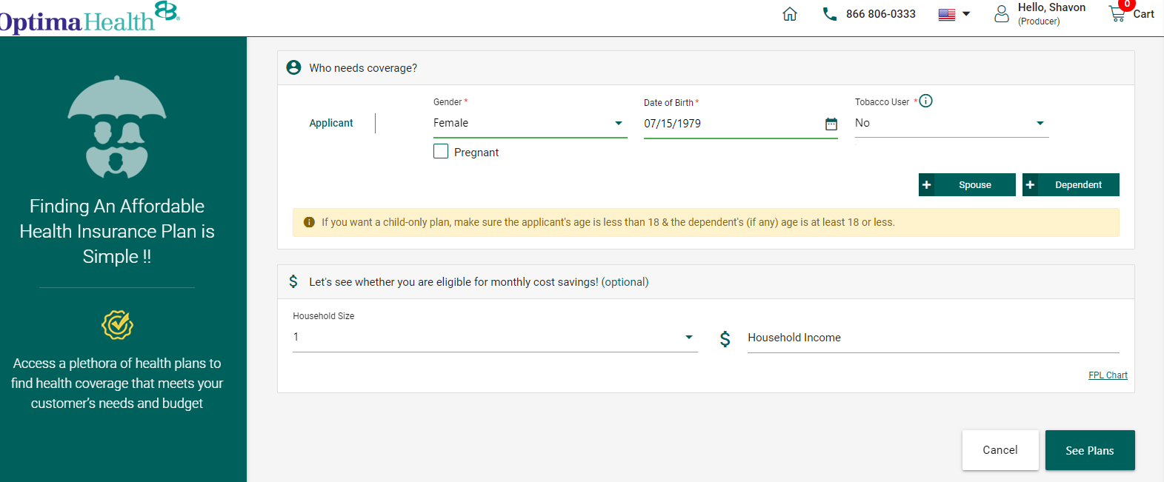
Enter client’s demographic information (continued) & “click” See Plans

Slide 11
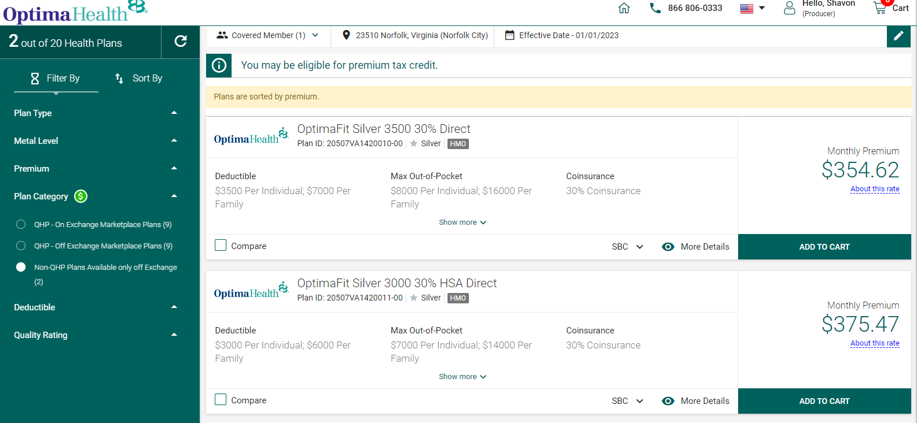
To see Unique Plans, select “Non-QHP Plans Available only off-exchange”

Slide 12
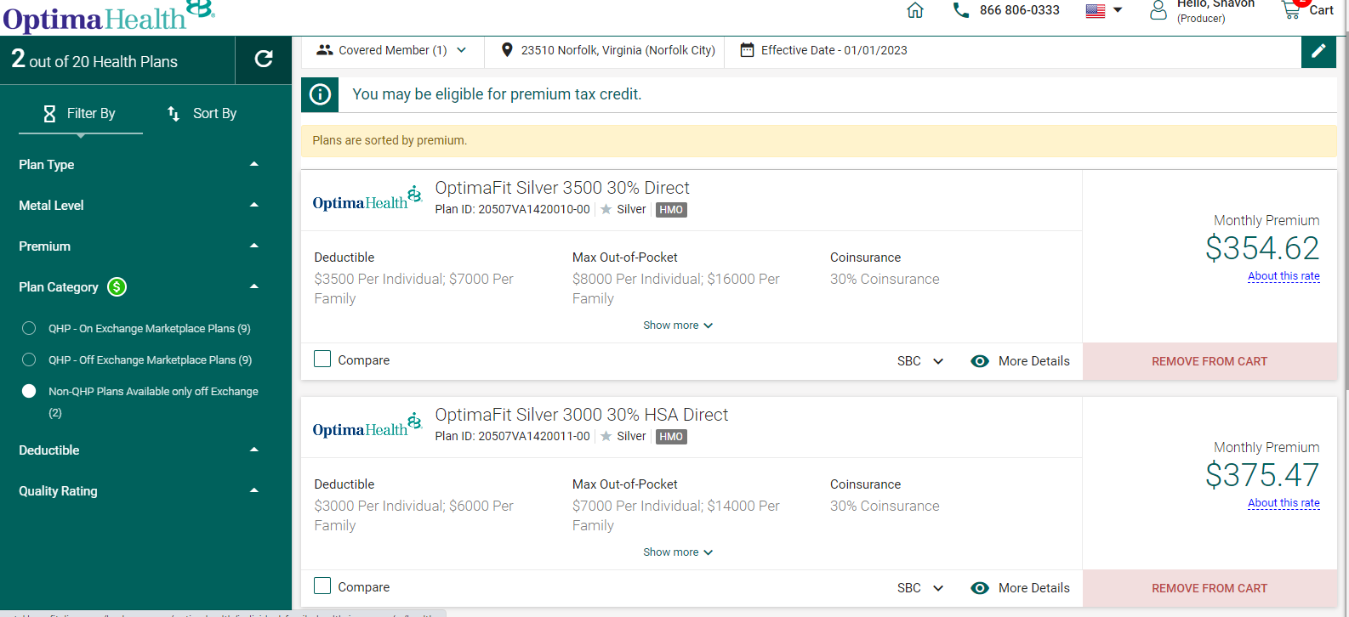
To generate a proposal, Add plans to cart

Slide 13
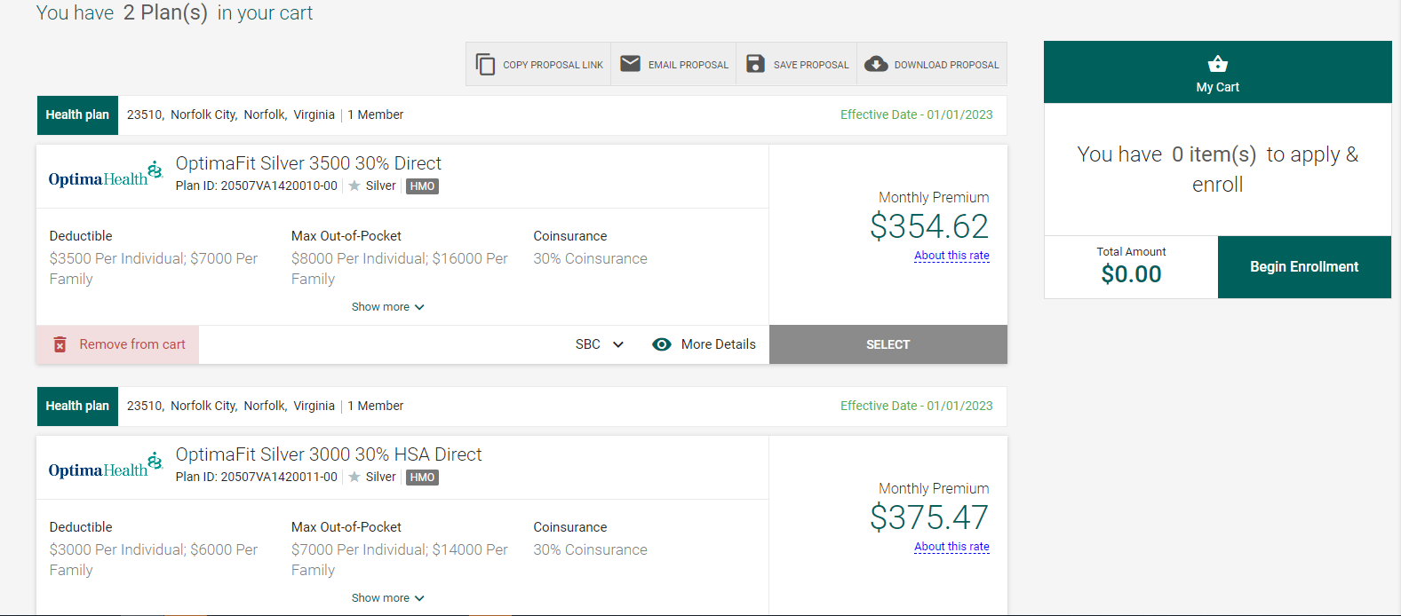
Option to “Copy Proposal Link”, Email, Save or Download Proposal.

Slide 14
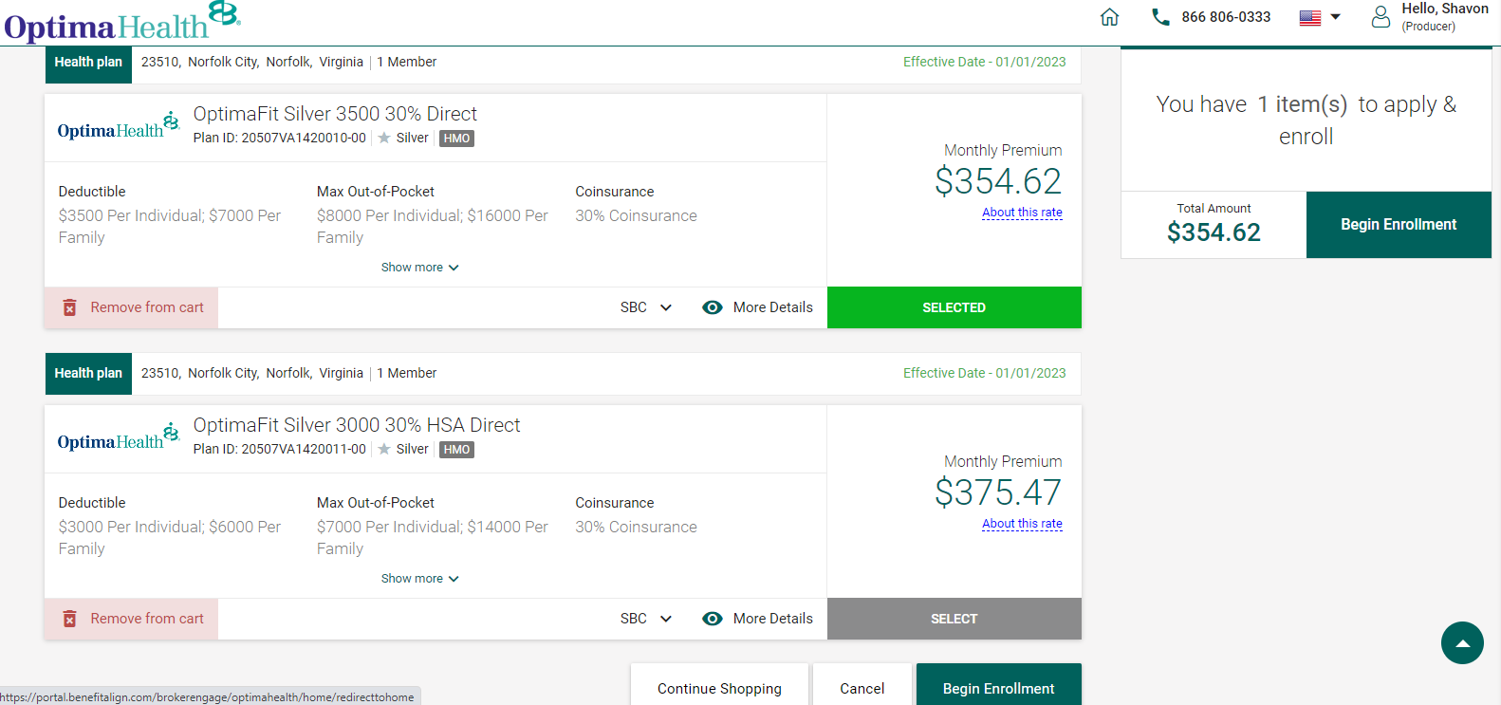
To enroll member, click “Select” on the plan of choice & “Begin Enrollment”.

